Slide 1
Data Warehousing 2019
Dimensional Modeling
Lec-10
Prepared by Bilal Khan

Slide 2
Requirements and Data Design
The requirements definition help to design for the data warehouse.
First phase is the Requirement Gathering.
Next phase is the documentation of the requirements gathering phase in detail is called Requirements Definition Document.
Main component of this phase is Information Packages.

Slide 3
Requirements and Data Design
The information package provide the base data design which is the next Phase.
Last phase is a dimensional data model.

Slide 4
Requirements and Data Design

Slide 5
Dimensional Modeling
Logical design technique to structure the business dimensions and the measurement to analyzed dimensions.

Slide 6
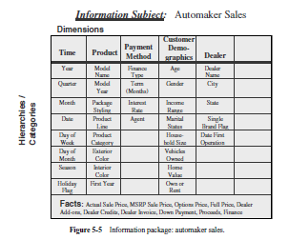
Dimensional Modeling
Fact contain the list of measurement that are used for analysis and fact value are usually numeric.

Slide 7
Dimensional Modeling
Business Dimensions

Slide 8
Dimensional Modeling
Fact Table
Different fact items are group together into single relational table.
Each fact item or measurement goes into the fact table as an attribute

Slide 9
Dimensional Modeling

Slide 10
Dimensional Modeling
The list of data items relating to the product dimension are as follows
Model name
Model year
Package styling
Product line
Product category
Exterior color
Interior color
First model year

Slide 11
Dimensional Modeling
Various dimension tables are formed from the information package diagram.

Slide 12
Dimensional Modeling
In dimensional model, the fact table are in the middle and the dimension tables arranged around the fact table.
Each of the dimension tables has a direct relationship with the fact table in the middle.
Such an arrangement in the dimensional model looks like a star formation, with the fact table at the core of the star and the dimension tables along the spikes of the star. The dimensional model is therefore called a STAR schema.

Slide 13
Dimensional Modeling

Slide 14
History For Dimensional Modeling

Slide 15
Dimensional Modeling
Early System
Problems with early data processing systems.
Data redundancies
From flat file to Table, each entity ultimately becomes a Table in the physical schema.

Slide 16
Dimensional Modeling
ER Model
Coupled with normalization drives out all the redundancy out of the database.
Update (or add or delete) the data at just one point.
Can be used with indexing for very fast access.
Resulted in success of OLTP systems.

Slide 17
CITY
DISTRICT
M
DIVISION
PROVINCE
1
district
1
1
zone
M
division
M
DISTRICT
DIVISION
ZONE
CITY
1
store
M
week
1
STORE #
STREET
ZONE
...
DATE
WEEK
1
M
sale_header
M
M
quarter
RECEIPT #
STORE #
DATE
...
MONTH
QTR
1
M
1
1
M
WEEK
MONTH
M
sale_detail
month
1
RECEIPT #
ITEM #
...
$
YEAR
QTR
1
M
M
year
1
ITEM #
CATEGORY
ITEM #
SUPPLIER
item_x_cat
M
1
item_x_splir
CATEGORY
DEPT
cat_x_dept

Slide 18
Dimensional Modeling
ER Model
All tables look-alike, as a consequence it is difficult to identify:
Which table is more important ?
Which is the largest?
Which tables contain numerical measurements of the business?

Slide 19
Dimensional Modeling
Problem in ER Model
Representation Complexity
Many topologies for the same ER diagram, all appearing different.
Very hard to visualize and remember.

Slide 20
Dimensional Modeling
Problem in ER Model
Representation Complexity
12
12
6
7
7
3
8
11
4
8
10
9
11
9
1
1
10
6
3
2
5
4
2
5
A large number of possible connections to any two (or more) tables

Slide 21
Need of Dimensional Modeling
The Paradox
Trying to make information accessible using tables resulted in an inability to query them!
ER and Normalization result in large number of tables which are:
Hard to understand by the users (DB programmers)
Too complex for queries that span multiple tables with a large number of records

Slide 22
Star Schema
In dimensional model, the fact table are in the middle and the dimension tables arranged around the fact table.
Each of the dimension tables has a direct relationship with the fact table in the middle.
Such an arrangement in the dimensional model looks like a star formation, with the fact table at the core of the star and the dimension tables along the spikes of the star. The dimensional model is therefore called a STAR schema.

Slide 23
Star Schema
Dimensional Table
Fact Table
Dimensional Table

Slide 24
Star Schema
The users will analyze the orders using dollar amounts, cost, profit margin, and sold quantity. These information are available in the fact table “Order Measures”
The user will analyze measurements by breaking down the numbers in combinations by customer, salesperson, date, and product.

Slide 25
Star Schema
A single fact table and for each dimension one dimension table
capture hierarchies directly
User can easily understand and work with the STAR schema.
The STAR schema structure answers the questions of what, when, where, which, who etc.

Slide 26
Star Schema
For a given amount of dollars :
what was the product sold?
Who was the customer?
Which salesperson brought the order?
When was the order placed?

Slide 27
Star Schema
In dimensional modeling a query are produced by joining one of more dimension tables with the fact table. The joins are between the fact table and individual dimension tables.

Slide 28
Star Schema

Slide 29
Star Schema
The user can study the business by drilling down to get at the details at the lower levels.
Example
Show me the total quantity sold of product Nokia N70 to customers in the Northeast Region for year 1999.
In the next step of the analysis is to drill down to the level of quarters in 1999 for the Northeast Region for the same product Nokia N70.
And So On . . .

Slide 30
Characteristics of Dimension Table

Slide 31
Characteristics of Dimension Table
Dimension table key
Dimensional table Surrogate uniquely identifies each row in the table.
Table is wide
A dimension table has many columns or attributes. Therefore, we say that the dimension table is wide.

Slide 32
Characteristics of Dimension Table
Textual attributes
In the dimension table, rarely attribute having numeric value which are used for calculations. The attributes in a dimension table are of textual format.

Slide 33
Characteristics of Dimension Table
Not normalized
A dimension table are usually not normalized
For efficient query performance, it is best if the query picks up an attribute from the dimension table and goes directly to the fact table and not through other intermediary tables.
Drilling down, rolling up
Dimension table provide the ability for attributes to get the details from higher levels of aggregation to lower levels of details.

Slide 34
Characteristics of Dimension Table

Slide 35
Characteristics of Dimension Table
Multiple hierarchies
Dimension tables may provide multiple hierarchies, so that drilling down may be performed along any of the multiple hierarchies.
Fewer number of records.
A dimension table has very fewer number of records or rows than the fact table.

Slide 36
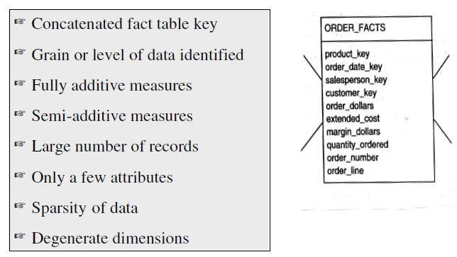
Characteristics of Fact Table

Slide 37
Characteristics of Fact Table
Concatenated Key
A row in the fact table relates to a combination of rows from all the dimension tables.
The primary key of the fact table must be the concatenation of the primary keys of all the dimension tables.
Data Grain
The data grain is the level of detail for analysis.

Slide 38
Characteristics of Fact Table
Fully Additive Measures
The values of attributes may be summed up by simple addition.
Aggregation of fully additive measures is done by simple addition.
Semiadditive Measures
Derived Attribute are not additive so called semiadditive.

Slide 39
Characteristics of Fact Table
Table Deep, Not Wide
A fact table contains very few attributes as compare to dimension table. Usually, there are about 10 attributes or less.
But the number of records in a fact table is very large
Example
Let we have 3 products, 5 customers, 30 days, and 10 sales representatives represented as rows in the dimension tables.
The number of row in fact table are 3*5*30*10 = 4500

Slide 40
Have a Nice Day

